Slide 1
Department of Computer Science & Engineering
UE17CS355 – Web Tech II Laboratory
Project Evaluation
Project Title : Pharmacy Website
Project Team :
<PES1201700147 – Likith R Shekar>
<PES1201700691 – Siddharth Shankar>
<PES1201700857 – Dinakar S M>

Slide 2
Project Description
A website which lets the user to buy their own drugs while giving them a complete detail on the knowledge of each drug including its components, side-effects, the manufacturing company while also including drugs that can serve as a viable replacement to it. The user can also be a reseller who runs his own pharmacy, it searches various companies and resellers for the drug that the user wants to buy. (Basically a pharma trivago)

Slide 3
Technologies Used
HTML, CSS, JavaScript and AJAX and jQuery for the frontend.
PHP and API’s for the backend.
XAMPP and MySQL for the database.

Slide 4
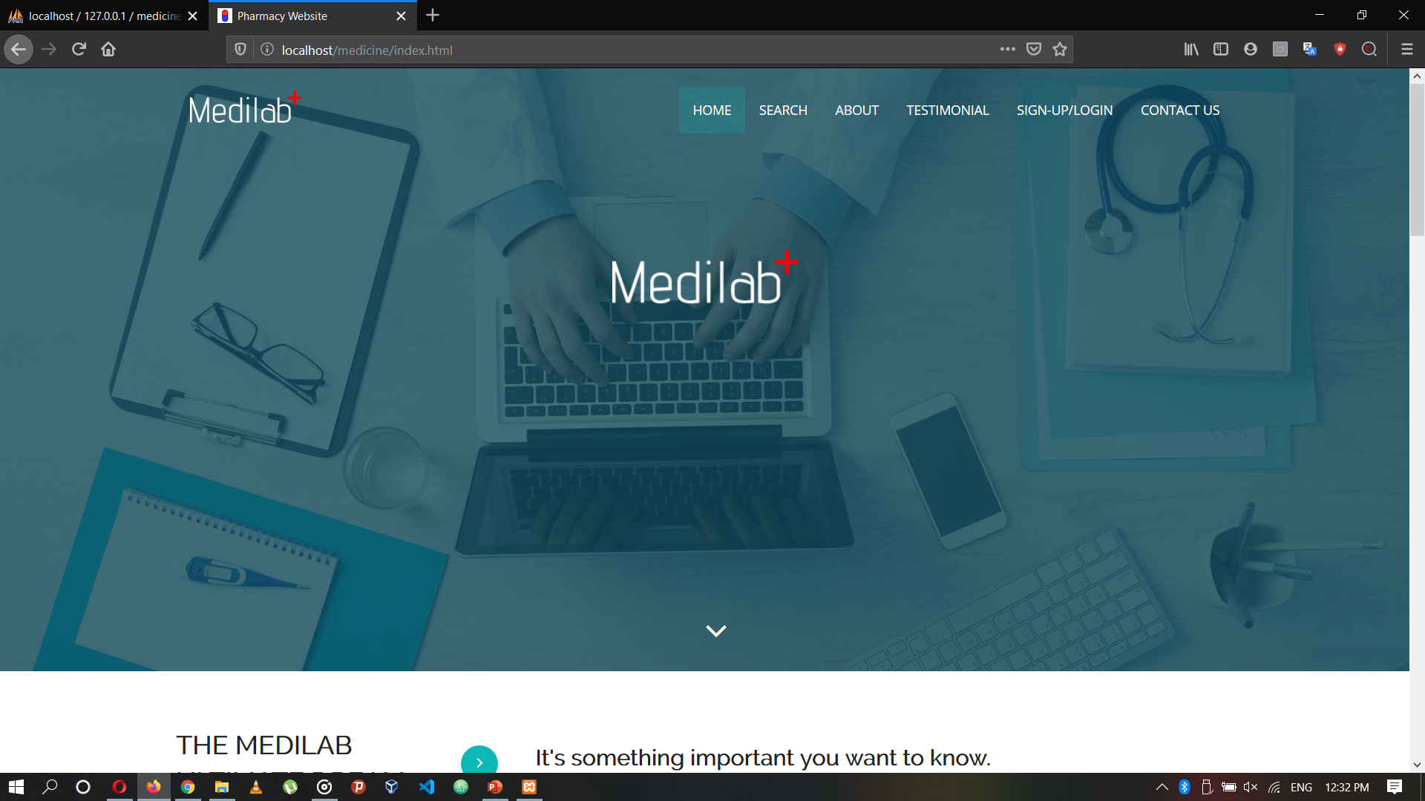
Techniques Implemented
The technique implemented is the Multistage Download.

Slide 5
Intelligent Functionality
We run an ML code which using the data from the previous orders predicts the three most probable orders which can be placed next.

Slide 6
Thank You

